Slide 1

Introduction to
Descriptive Statistics
Eslam Ahmed
Software Engineer

Slide 2
Understanding Data, Variables/Features

Slide 3

Understanding The Variables Using a Dataset
Loan_ID | Gender | Married | Dependents | Self_Employed | Income | LoanAmt | Term | CreditHistory | Property_Area | Status
LP001002 | Male | No | 0 | No | $5,849.00 |  | 60 | 1 | Urban | Y
LP001003 | Male | Yes | 1 | No | $4,583.00 | $128.00 | 120 | 1 | Rural | N
LP001005 | Male | Yes | 0 | Yes | $3,000.00 | $66.00 | 60 | 1 | Urban | Y
LP001006 | Male | Yes | 2 | No | $2,583.00 | $120.00 | 60 | 1 | Urban | Y
Qualitative
Quantitative
Nominal
Ordinal
Discrete
Continuous
Gender
Married
Self employed Property Area Status
Credit History
Dependents
Term
Income
LoanAmt

Slide 4
Understanding The Variables Using a Dataset
Loan_ID | Gender | Married | Dependents | Self_Employed | Income | LoanAmt | Term | CreditHistory | Property_Area | Status
LP001002 | Male | No | 0 | No | $5,849.00 |  | 60 | 1 | Urban | Y
LP001003 | Male | Yes | 1 | No | $4,583.00 | $128.00 | 120 | 1 | Rural | N
LP001005 | Male | Yes | 0 | Yes | $3,000.00 | $66.00 | 60 | 1 | Urban | Y
LP001006 | Male | Yes | 2 | No | $2,583.00 | $120.00 | 60 | 1 | Urban | Y
Types of Variables
Data Type
Predictor/Independent
Gender
Married
Dependents
Self_Employed
Income
LoanAmt
Term
CreditHistory
PropertyArea
Character/String
Gender
Married
Self_Employed
Property_Area
Status
Numeric
Dependents
Income
LoanAmt
Term
CreditHistory
Target/Dependent
Status

Slide 5
Central Tendency of Data

Slide 6
Central Tendency
Single value that attempts to describe the whole data using a central point or central location of the data.

Slide 7




Central Tendency of Data

Slide 8
Central Tendency
Mean
Median
Mode
Others – Geometric mean, Harmonic Mean, Weighted Arithmetic Mean

Slide 9
Mean
Applicant | Loan Amount
Jitesh | $ 24,000
John | $ 18,000
Frans | $ 34, 000
Danny | $ 40,000
Cecile | $ 24,000
Scott | $ 16,000
Alex | $ 29,000
24000 + 18000 + 34000 + 40000 + 24000 + 16000 + 29000
Mean =
7
=
151000
7
Mean = $25,167

Slide 10
Median
Applicant | Loan Amount
Jitesh | $ 24,000
John | $ 18,000
Frans | $ 34, 000
Danny | $ 40,000
Cecile | $ 24,000
Scott | $ 16,000
Alex | $ 29,000
$24,000
$18,000
$34,000
$40,000
$24,000
$16,000
$29,000
$16,000
$18,000
$24,000
$24,000
$29,000
$34,000
$40,000
1
2
3
4
5
6
7
Median
Median = $24,000

Slide 11
Mode
Applicant
Loan Amount
Jitesh
$ 24,000
John
$ 18,000
Frans
$ 34, 000
Mode = $24,000
Danny
$ 40,000
Cecile
$ 24,000
Scott
$ 16,000
Alex
$ 29,000

Slide 12
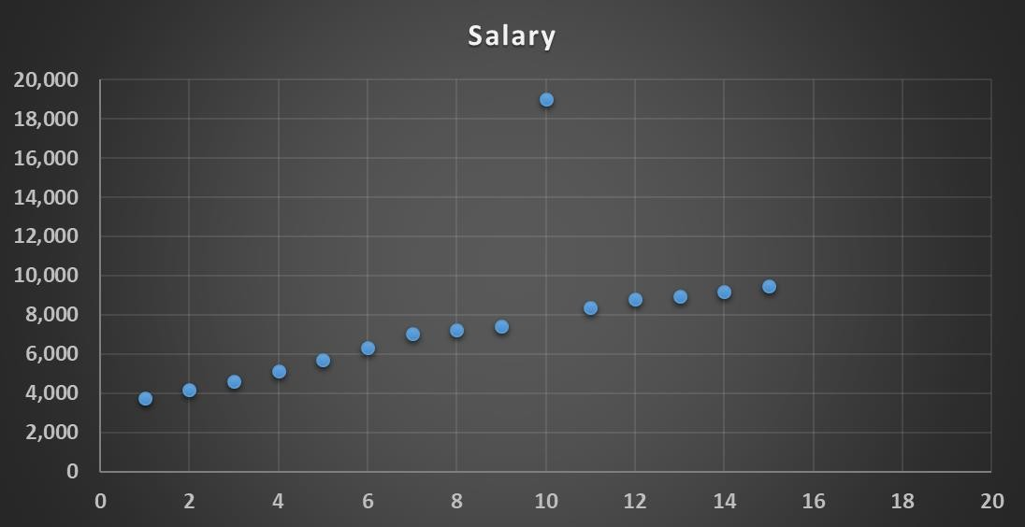
Outliers
Experience | Salary
1 | $ 3,725
2 | $ 4,155
3 | $ 4,627
4 | $ 5,147
5 | $ 5,718
6 | $ 6,347
7 | $ 7,039
8 | $ 7,210
9 | $ 7,423
10 | $ 19,000
11 | $ 8,369
12 | $ 8,810
13 | $ 8,940
14 | $ 9,200
15 | $ 9,458

Slide 13
Effect of Outliers
Experience | Salary
1 | $ 3,725
2 | $ 4,155
3 | $ 4,627
4 | $ 5,147
5 | $ 5,718
6 | $ 6,347
7 | $ 7,039
8 | $ 7,210
9 | $ 7,423
10 | $ 7,556
11 | $ 8,369
12 | $ 8,810
13 | $ 8,940
14 | $ 9,200
15 | $ 9,458
Experience | Salary
1 | $ 3,725
2 | $ 4,155
3 | $ 4,627
4 | $ 5,147
5 | $ 5,718
6 | $ 6,347
7 | $ 7,039
8 | $ 7,210
9 | $ 7,423
10 | $ 19,000
11 | $ 8,369
12 | $ 8,810
13 | $ 8,940
14 | $ 9,200
15 | $ 9,458
$ 6,915
← Mean →
$ 7,678
$ 7,200 ← Median →
$ 7,200

Slide 14
Measure of Dispersion

Slide 15
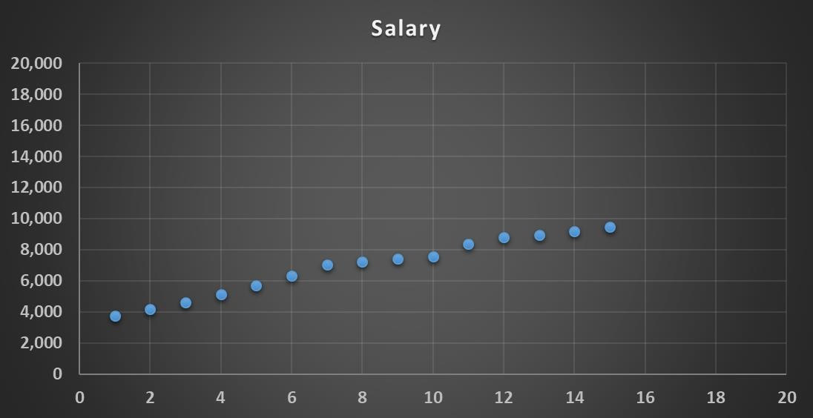
Central Tendency
Mean
Median

Slide 16
Spread in Data
Spread

Slide 17
Spread in Data
Day Temperature
1 20
2 21
3 19
4 20
5 21
6 19
7 20
Total 140
Mean = 20
Median = 20
Day
Temperature
Day
Temperature
1
22
1
12
2
23
2
11
3
21
3
13
4
18
4
20
5
19
5
24
6
17
6
29
7
20
7
31
Total 140
Mean = 20
Median = 20
Total 140
Mean = 20
Median = 20

Slide 18

Measure of Dispersion
Variance
Standard Deviation
Percentile
Range
Interquartile range

Slide 19
Variance and Standard Deviation
Day | X | X – X | 2 (X – X )
1 | 20 | 0 | 0
2 | 21 | 1 | 1
3 | 19 | -1 | 1
4 | 20 | 0 | 0
5 | 21 | 1 | 1
6 | 19 | -1 | 1
7 | 20 | 0 | 0
Average = 4/7 = 0.57
σ
2
Variance,
= 0.57
σ = 0.7559
Mean = X = 20

Slide 20
Variance and Standard Deviation
Day | Temperature
1 | 20
2 | 21
3 | 19
4 | 20
5 | 21
6 | 19
7 | 20
Day | Temperature
1 | 12
2 | 11
3 | 13
4 | 20
5 | 24
6 | 29
7 | 31
σ = 0.7559
Mean = X = 20
σ = 7.67
Mean = X = 20

Slide 21
What is Percentile?
The value below which a given percentage of observations in a group of observations falls…
– Wikipedia

Slide 22
Percentile
Arrange the data in an order
Calculate the percentage of observations or data points below a particular value.
What is the 80th Percentile Observation?
Row Number | Salary
1 | $ 3,725
2 | $ 4,155
3 | $ 4,627
4 | $ 5,147
5 | $ 5,718
6 | $ 6,347
7 | $ 7,039
8 | $ 7,210
9 | $ 7,423
10 | $ 7,556
11 | $ 8,369
12 | $ 8,810
13 | $ 8,940
14 | $ 9,200
15 | $ 9,458
Total Observations * 0.8
15 * 0.8 = 12

Slide 23
Range
Difference between the highest and lowest value…

Slide 24
Range
Day | Temperature |  | Day | Temperature |  | Day | Temperature
1 | 20 |  | 1 | 22 |  | 1 | 12
2 | 21 |  | 2 | 23 |  | 2 | 11
3 | 19 |  | 3 | 21 |  | 3 | 13
4 | 20 |  | 4 | 18 |  | 4 | 20
5 | 21 |  | 5 | 19 |  | 5 | 24
6 | 19 |  | 6 | 17 |  | 6 | 29
7 | 20 |  | 7 | 20 |  | 7 | 31
Mean = 20
Range = 2
Mean = 20
Range = 6
Mean = 20
Range = 20

Slide 25
Inter Quartile Range (IQR)
Row Number | Salary
1 | $ 3,725
2 | $ 4,155
3 | $ 4,627
4 | $ 5,147
5 | $ 5,718
6 | $ 6,347
7 | $ 7,039
8 | $ 7,210
9 | $ 7,423
10 | $ 7,556
11 | $ 8,369
12 | $ 8,810
13 | $ 8,940
14 | $ 9,200
15 | $ 9,458
1st Quartile
Q3 – Q1
Inter Quartile Range IQR
Median
$8,810 – $5,147 = $3,663
3rd Quartile

Slide 26
How to Show Numerical Data?

Slide 27
Visualize Numerical Data
Frequency Table
Histogram
Bar Chart
Boxplot

Slide 28
Frequency Table
1223
3434
4545
6798
2311
4321
5600
10345
900
2687
3450
6700
2340
3600
5632
7900
0-2000 | 2-4000 | 4-6000 | 6-8000 | > 8000
1223 | 3434 | 4545 | 6798 | 10345
900 | 2311 | 4321 | 6700
 | 2687 | 5600 | 7900
 | 3450 | 5632
 | 2340
 | 3600
2 | 6 | 4 | 3 | 1

Slide 29
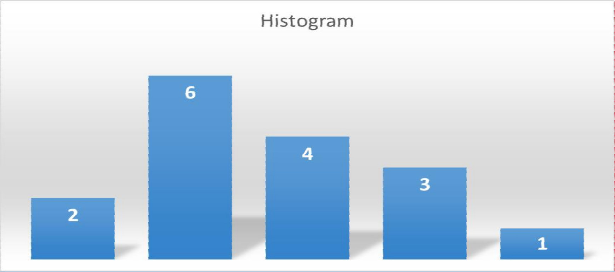
Histogram
1223
3434
4545
6798
2311
4321
5600
10345
900
2687
3450
6700
2340
3600
5632
7900
0-2000 | 2-4000 | 4-6000 | 6-8000 | > 8000
2 | 6 | 4 | 3 | 1

Slide 30
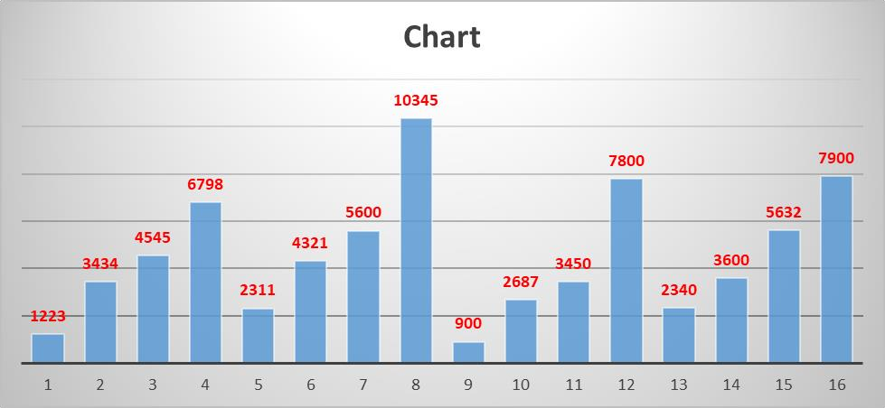
Bar Chart
1223
3434
4545
6798
2311
4321
5600
10345
900
2687
3450
6700
2340
3600
5632
7900

Slide 31

Box Plot
Outlier
3rd Quartile + 1.5 IQR Or
95 percentile
Maximum
3rd Quartile
Interquartile Range
Median
1st Quartile
Minimum
1st Quartile - 1.5 IQR Or
5 percentile

Slide 32




Correlation
Number of cigarettes smoked
Stress Level

Slide 33
Statistically Correlated
Y
Strength of the correlation – Coefficient of Correlation
Direction of correlation – Sign of the Coefficient
𝛴 (x – x ) * (y – y )
Pearson Correlation
Coefficient
r =
X
(N – 1) * 𝜎_{x} * 𝜎_{y}

Slide 34
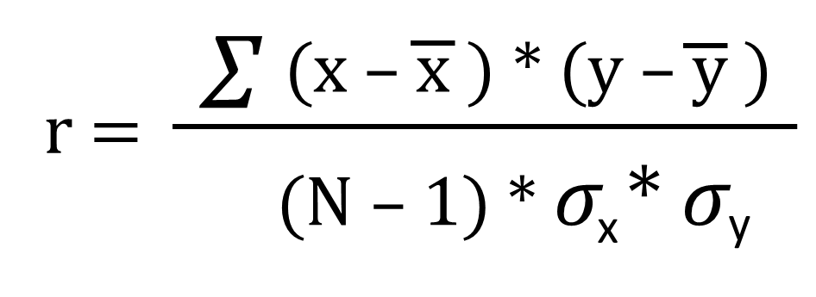
Correlation Coefficient
 | Height X | Weight Y | X – X | Y – Y | (X – X ) * (Y – Y )
 | 160 | 130 | -15.625 | -40.625 | 634.7656
 | 170 | 150 | -5.625 | -20.625 | 116.0156
 | 165 | 145 | -10.625 | -25.625 | 272.2656
 | 180 | 190 | 4.375 | 19.375 | 84.76563
 | 175 | 175 | -0.625 | 4.375 | -2.73438
 | 190 | 210 | 14.375 | 39.375 | 566.0156
 | 185 | 180 | 9.375 | 9.375 | 87.89063
 | 180 | 185 | 4.375 | 14.375 | 62.89063
Mean | 175.625 | 170.625 |  |  | 1821.875
Std Dev | 10.155 | 25.651
r =
1821.875
(8-1) * 10.155 * 25.651
r = 0.96

Slide 35
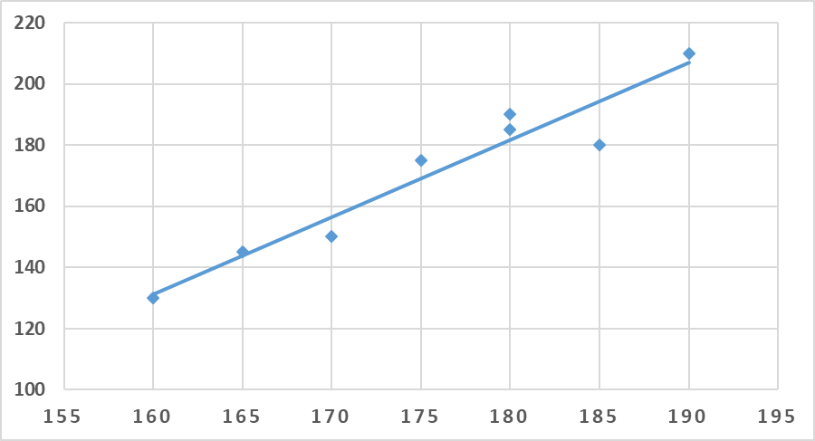
Correlation Coefficient
r =
1821.875
(8-1) * 10.155 * 25.651
r = 0.96
Scatter Plot

Slide 36
Y
Strong Positive Correlation
Y
Weak Positive Correlation
r = +0.9
r = +0.6
X
X
Y
No Correlation
Y
Strong Negative Correlation
r = 0.005
r = – 0.8
X
X

Slide 37
Covariance

Slide 38
Variance
Average of the squared difference of the data from the Mean.
𝛴 (x – x ) * (x – x )
2
Variance of X with respect to X.
Variance, S_{x} =
(N – 1)

Slide 39
𝛴 (x – x ) * (y – y )
Covariance
Variance of X with respect to Y.
Covariance, S ² =
xy
(N – 1)

Slide 40
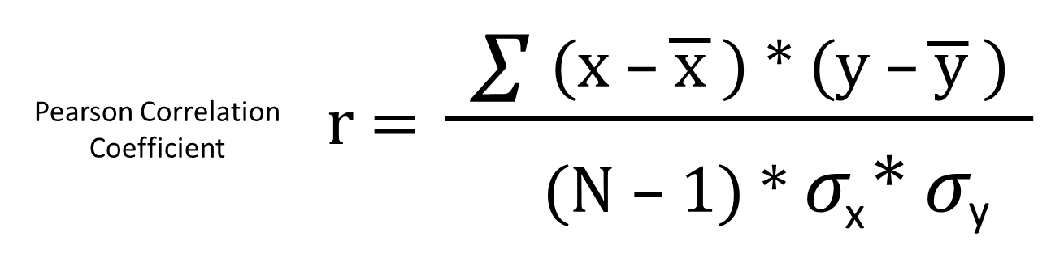
Covariance
Covar (x, y)
=
𝜎_{x} * 𝜎_{y}
𝛴 (x – x ) * (y – y )
Variance of X with respect to Y.
Covariance, S ² =
xy
(N – 1)

Slide 41
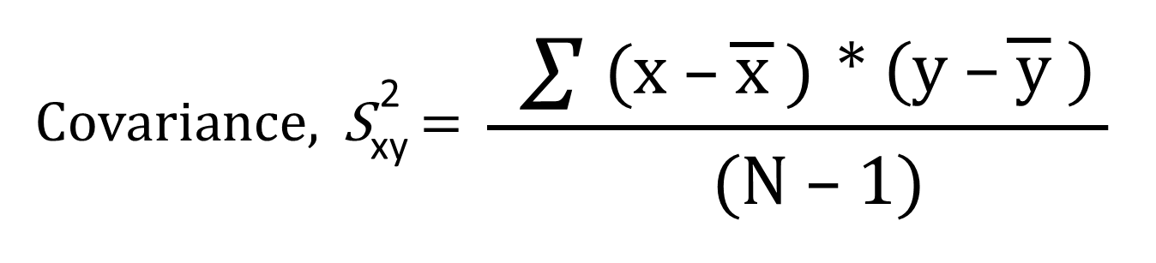
Covariance
 | Height X | Weight Y | X – X | Y – Y | (X – X ) * (Y – Y )
 | 160 | 130 | -15.625 | -40.625 | 634.7656
 | 170 | 150 | -5.625 | -20.625 | 116.0156
 | 165 | 145 | -10.625 | -25.625 | 272.2656
 | 180 | 190 | 4.375 | 19.375 | 84.76563
 | 175 | 175 | -0.625 | 4.375 | -2.73438
 | 190 | 210 | 14.375 | 39.375 | 566.0156
 | 185 | 180 | 9.375 | 9.375 | 87.89063
 | 180 | 185 | 4.375 | 14.375 | 62.89063
Mean | 175.625 | 170.625 |  |  | 1821.875
Std Dev | 10.155 | 25.651
Covar (x, y) =
1821.875
(8-1)
Covar (x, y) = 260.27

Slide 42
Covariance
Non-Standardised method of correlation
Can be positive or negative
Covar (x, y) =
1821.875
(8-1)
Covar (x, y) = 260.27

Slide 43
Covariance Matrix
 | Height X | Weight Y | X – X | Y – Y | (X – X ) * (Y – Y )
 | 160 | 130 | -15.625 | -40.625 | 634.7656
 | 170 | 150 | -5.625 | -20.625 | 116.0156
 | 165 | 145 | -10.625 | -25.625 | 272.2656
 | 180 | 190 | 4.375 | 19.375 | 84.76563
 | 175 | 175 | -0.625 | 4.375 | -2.73438
 | 190 | 210 | 14.375 | 39.375 | 566.0156
 | 185 | 180 | 9.375 | 9.375 | 87.89063
 | 180 | 185 | 4.375 | 14.375 | 62.89063
Mean | 175.625 | 170.625 |  |  | 1821.875
Std Dev | 10.155 | 25.651
x
y
x y
Covariance (x, x) | Covariance(x, y)
Covariance (y, x) | Covariance (y, y)

Slide 44

Covariance Matrix
 | Height X | Weight Y | X – X | Y – Y | (X – X ) * (Y – Y )
 | 160 | 130 | -15.625 | -40.625 | 634.7656
 | 170 | 150 | -5.625 | -20.625 | 116.0156
 | 165 | 145 | -10.625 | -25.625 | 272.2656
 | 180 | 190 | 4.375 | 19.375 | 84.76563
 | 175 | 175 | -0.625 | 4.375 | -2.73438
 | 190 | 210 | 14.375 | 39.375 | 566.0156
 | 185 | 180 | 9.375 | 9.375 | 87.89063
 | 180 | 185 | 4.375 | 14.375 | 62.89063
Mean | 175.625 | 170.625 |  |  | 1821.875
Std Dev | 10.155 | 25.651
x
y
x y
Variance(x) | Covariance(x, y)
Covariance (y, x) | Variance (y)
Variance – Covariance Matrix

Slide 45
Covariance Matrix
 | Height X | Weight Y | X – X | Y – Y | (X – X ) * (Y – Y )
 | 160 | 130 | -15.625 | -40.625 | 634.7656
 | 170 | 150 | -5.625 | -20.625 | 116.0156
 | 165 | 145 | -10.625 | -25.625 | 272.2656
 | 180 | 190 | 4.375 | 19.375 | 84.76563
 | 175 | 175 | -0.625 | 4.375 | -2.73438
 | 190 | 210 | 14.375 | 39.375 | 566.0156
 | 185 | 180 | 9.375 | 9.375 | 87.89063
 | 180 | 185 | 4.375 | 14.375 | 62.89063
Mean | 175.625 | 170.625 |  |  | 1821.875
Std Dev | 10.155 | 25.651
x
y
x y
103.125 | 260.27
260.27 | 710.26
Variance – Covariance Matrix

Slide 46
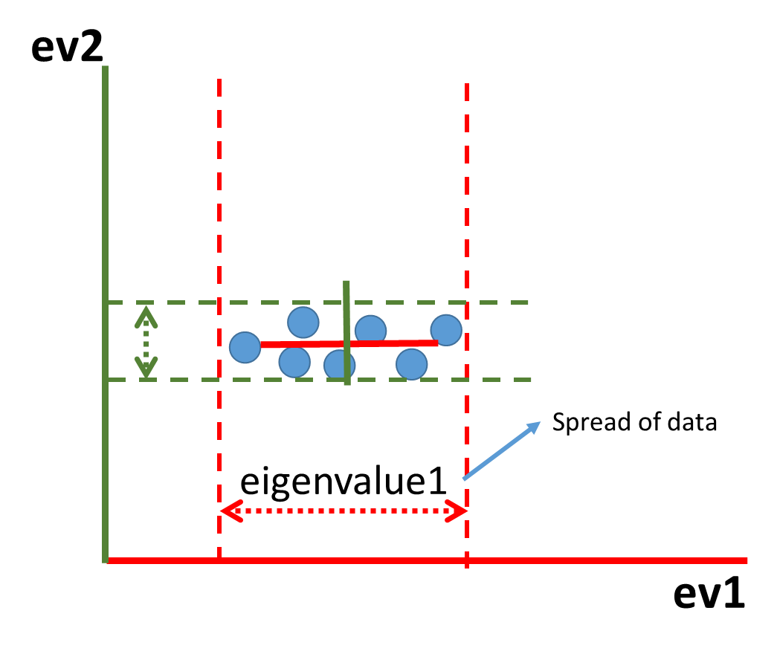
Covariance Applications
Using Covariance matrix as Transformation
Matrix to get Eigenvectors and EigenValues
Financial Portfolio Management

Slide 47
Thank You!

